Slide 1

DEPARTMENT OF COMPUTER SCIENCE AND ENGINEERING
INTERDISCIPLINARY PROJECT
Traffic Accidents Analysis Report
PROJECT STUDENT GUIDE
Vaikundaraja R, 42111390 Dr. M. S. Roobini, M.E.,Ph.D., Assistant Professor, CSE

Slide 2
AGENDA
Certificate
Introduction
Abstract
Objective
System Architecture / Ideation Map
Tools Used
Module Implementation
Results and Discussions
Conclusion
References

Slide 3
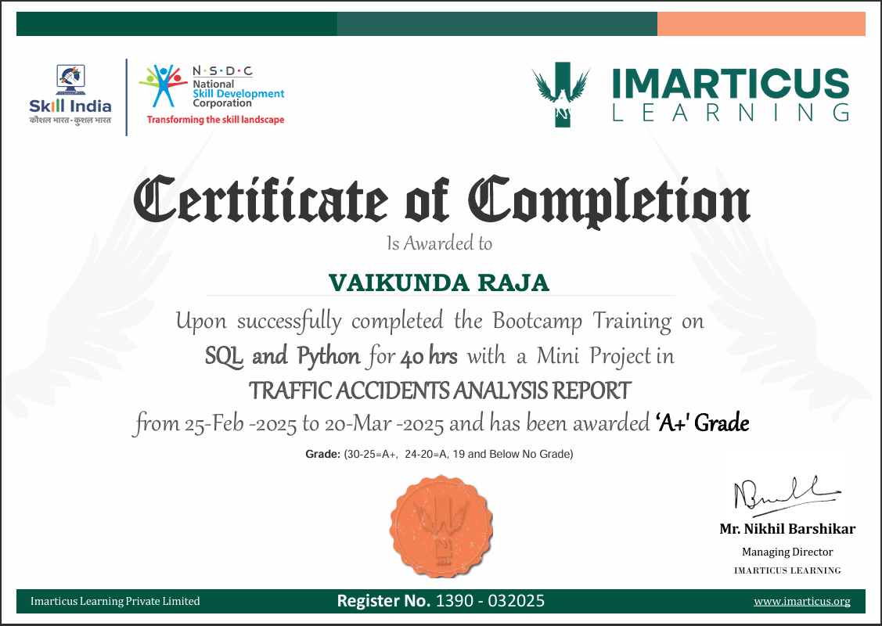
COURSE CERTIFICATE

Slide 4
Introduction
The analysis of traffic accidents has become essential due to the rise in urbanization and the number of vehicles on the road. With the help of data analytics, we can gain insights into accident patterns, causes, and frequency. This project utilizes SQL Server and Python (with Pandas and Matplotlib) to connect, analyze, and visualize traffic accident data. The goal is to help identify critical areas for improvement in traffic management and safety measures.

Slide 5
Abstract
This project focuses on the comprehensive analysis of traffic accident data to discover hidden trends and patterns that contribute to accidents. By leveraging data from a SQL Server database and Python libraries, we perform statistical and visual analysis of key factors such as time, weather, light conditions, and causes of crashes. The visualizations generated assist in understanding accident distributions and their severity. The study ultimately aims to provide insights to improve road safety and reduce accident rates.

Slide 6
Objective
To connect SQL Server with Python using PyODBC for efficient data extraction.
To clean and preprocess the traffic accident dataset using Pandas.
To visualize key parameters such as crash type, time of day, lighting conditions, and primary cause using Matplotlib.
To uncover patterns that highlight risk-prone conditions for traffic accidents.
To summarize findings that can help traffic authorities take data-driven safety actions.

Slide 7
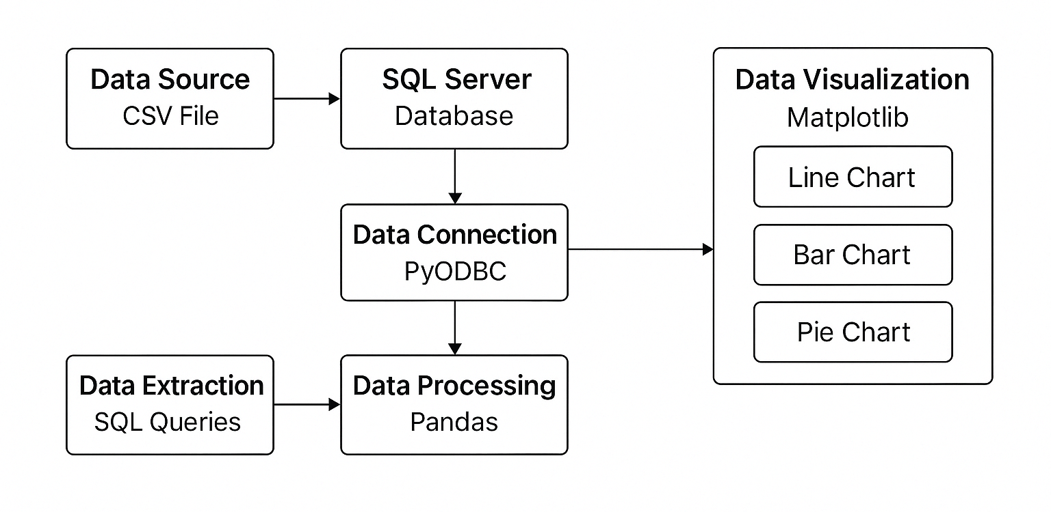
System Architecture / Ideation Map

Slide 8
TOOLS USED
Database (for storing accident data)
MySQL / PostgreSQL / SQLite: To store traffic accident data like time, location, vehicle type, cause, etc.
Use SQL to query data for analysis.
Python Libraries
Pandas: For data manipulation and cleaning.
Matplotlib: For visualization of trends, and distributions.
PyOdbc: For connecting SQL & Python

Slide 9
Module Implementation
The project begins by uploading a CSV file into a SQL Server database. Using PyODBC, the data is queried and loaded into a Pandas DataFrame. Essential data preprocessing is done to convert columns like date, hour, and cause into analyzable formats.
Multiple visualization techniques are used:
Line charts to track accident trends over time.
Bar charts for frequency of crashes by hour, day, and weather.
Pie and donut charts to showcase proportional data such as crash types and severity.
The visualizations were created using Matplotlib.

Slide 10
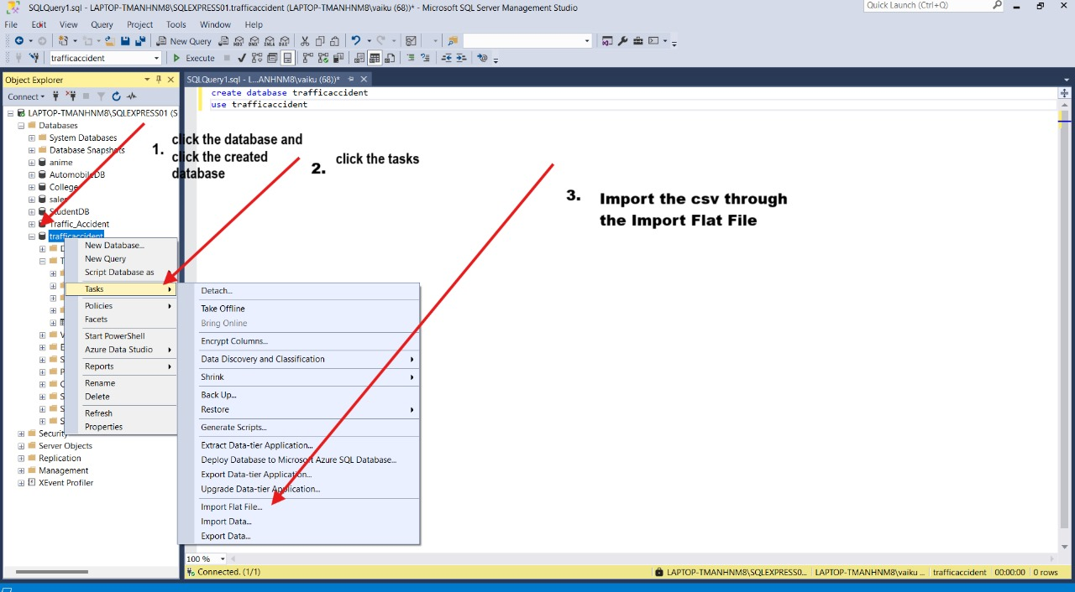
Module Implementation

Slide 11
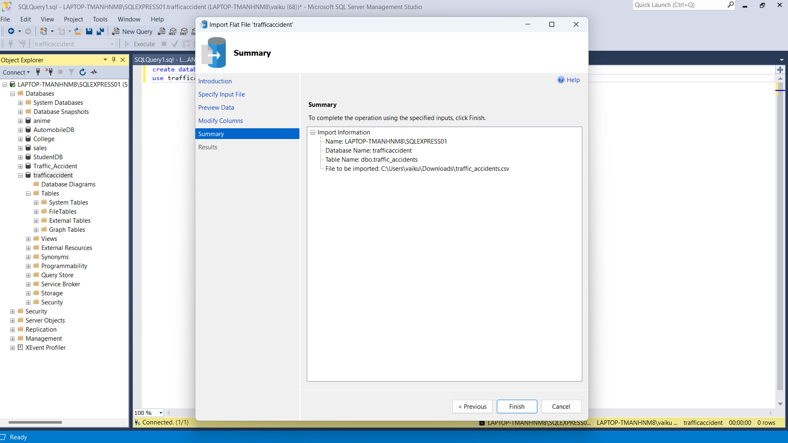
Module Implementation

Slide 12
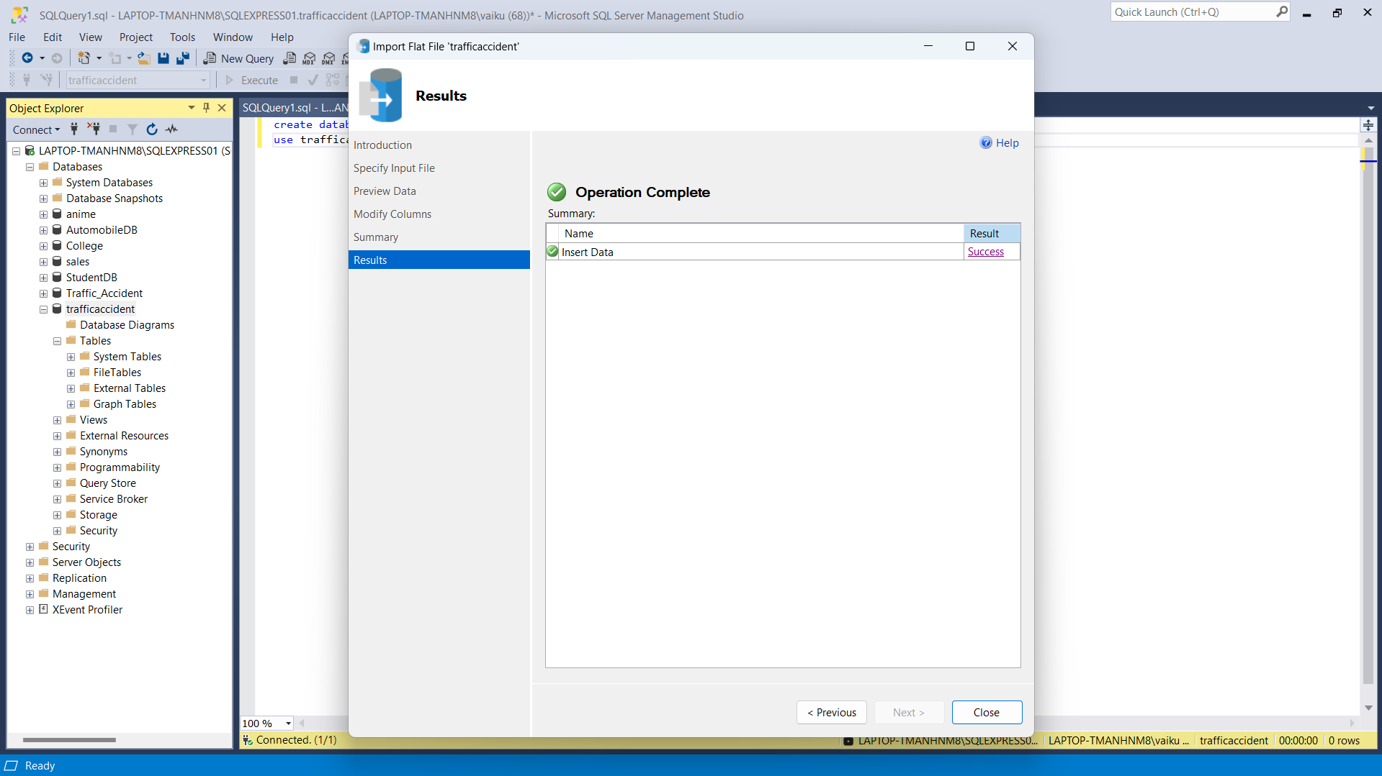
Module Implementation

Slide 13
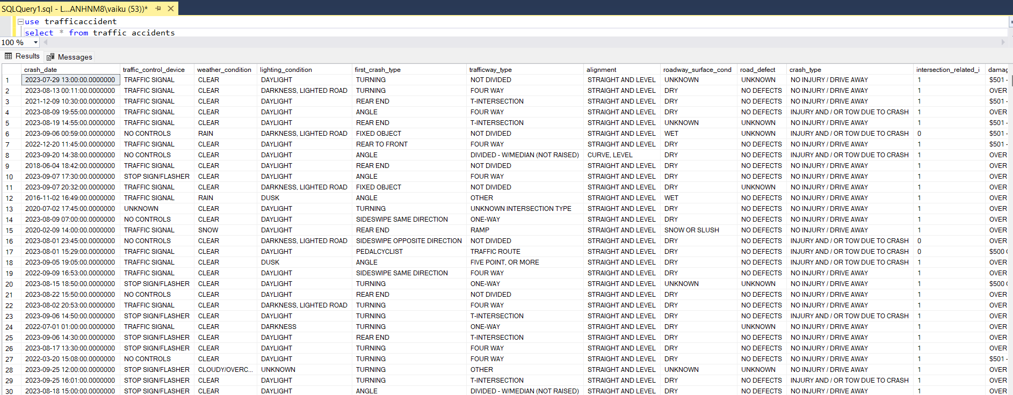
Module Implementation

Slide 14
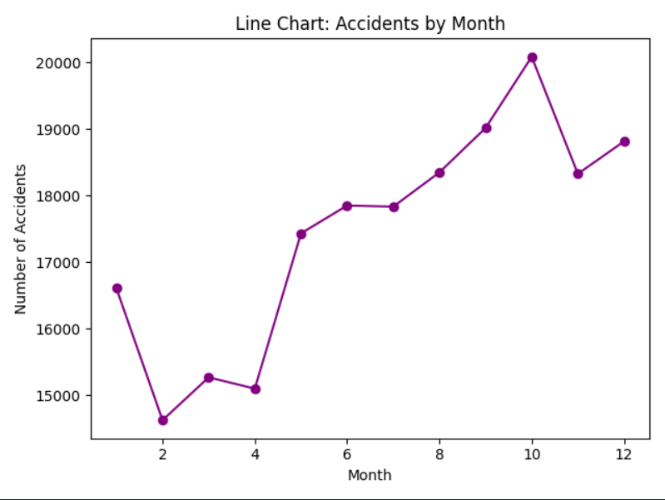
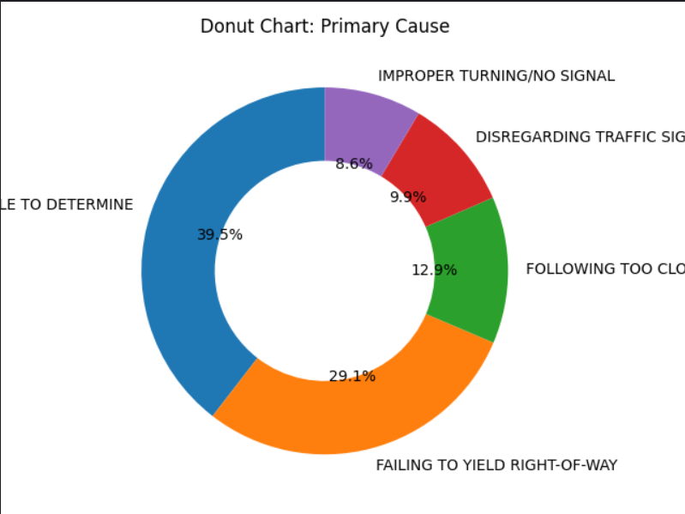
Module Implementation

Slide 15
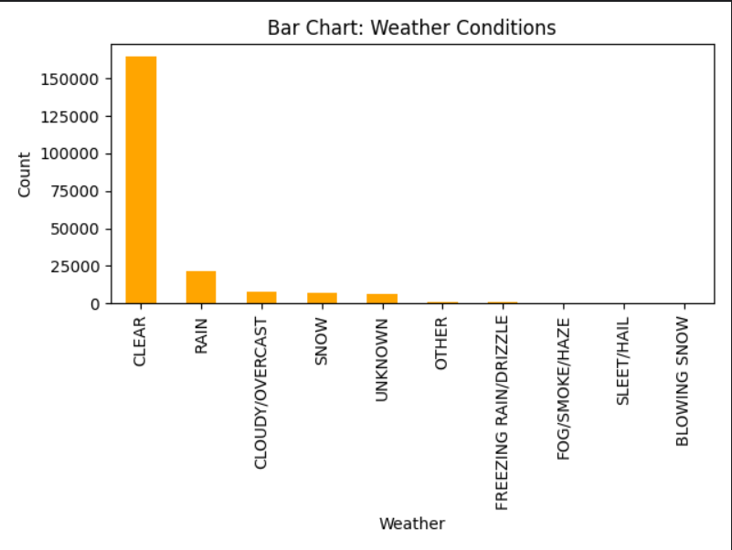
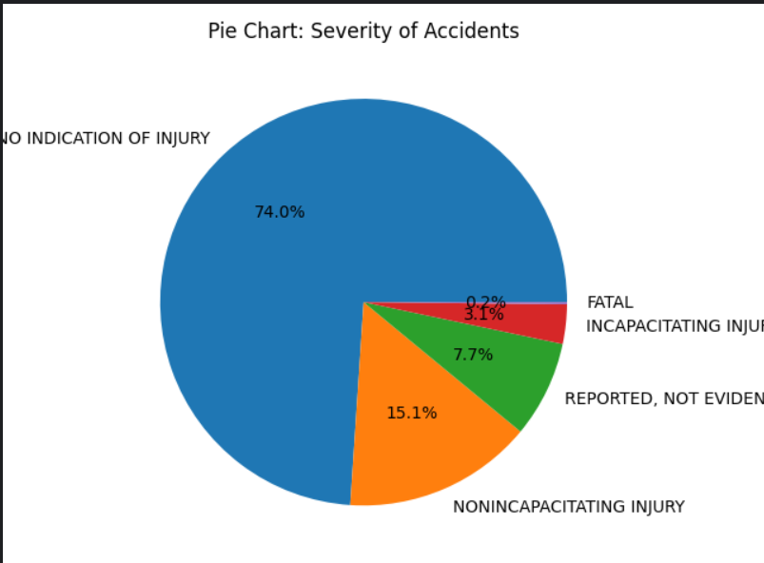
Module Implementation

Slide 16
Results and Discussions
The analysis revealed that:
Most accidents occurred during specific hours of the day, highlighting peak-risk periods.
Certain weather and lighting conditions contributed more significantly to crash frequency.
The majority of crashes were caused by a few common factors like distracted driving.
There’s a correlation between number of vehicles and injury severity.
These insights help in planning targeted awareness campaigns and implementing road safety rules based on data-driven findings.

Slide 17
Conclusion
The project successfully demonstrated how integrating SQL and Python can facilitate effective data analysis and visualization of traffic accident data. From identifying peak accident times to analyzing contributing factors, the study provided actionable insights. These findings can be used to inform policy makers and improve road safety strategies. This project sets the stage for further advanced analysis using machine learning or geospatial mapping in future developments.

Slide 18
REFERENCES
Kaggle Traffic Accident Dataset – https://www.kaggle.com (Search: Traffic Accident or Road Crash Dataset)
Python Documentation – https://docs.python.org
Pandas Library Documentation – https://pandas.pydata.org
MatplotlibDocumentation-https://matplotlib.org/stable/contents.html
SQL-Server-Documentation-MicrosoftDocs: https://docs.microsoft.com/sql
PyODBC Library – https://github.com/mkleehammer/pyodbc

Slide 19
THANK YOU
We thank God, Our Department, Guide, Panel Members, Supportive Professors and all Technical and non Technical staff who helped us in our Project.

